Slide 1


INTEGRATED PROJECT – SUMMER 2024
Distributional Quantities & Exposure Rating
Team Arocha
Actuarial Science Program
May 24, 2024

Slide 2
TABLE OF CONTENTS
01 | Recap from last session
02 | Limited Loss Random Variable and Limited Expected Value
03 | Loss Elimination Ratio
04 | Exposure Rating

Slide 3
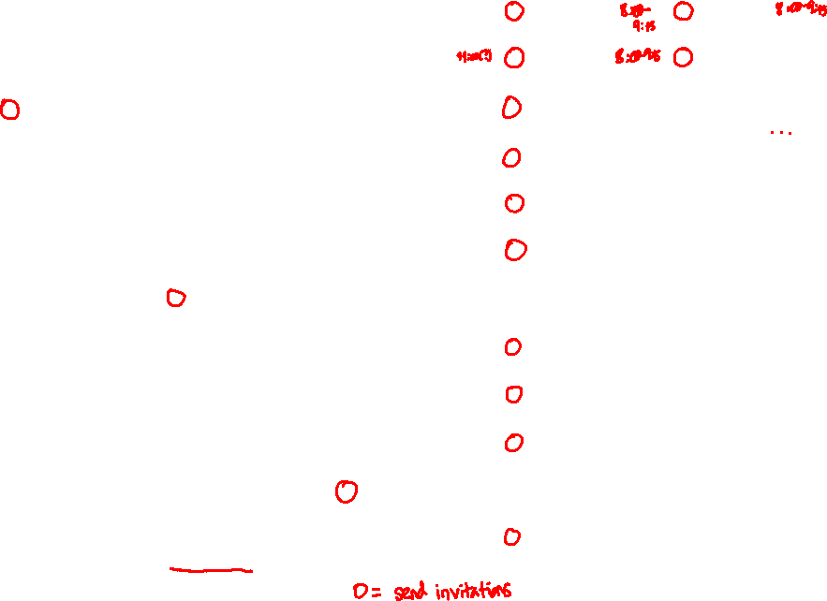

Slide 4
Business Context
Columbia Insurance Company (CIC) writes property insurance for individuals and companies
Property insurance indemnifies the insured for the loss or damage to the insured’s property, such as one’s house or one’s car
Property policies are characterized by short-tail claims and a relatively low frequency of significant claims
The severity of the claims is usually capped by the maximum value of the property, but most losses will be smaller than the maximum probable loss (MPL)
The accurate pricing of property often requires the use of catastrophe models and market severity curves (also known as exposure curves)

Slide 5
Problem Definition
Over the past few years, CIC has experienced significant growth.
Initially focused solely on homeowners’ insurance, CIC has now diversified its product palette to include commercial and industrial property, auto, marine cargo, aviation hull, and other lines. To improve its pricing strategy, CIC aims to redefine its risk classes and charge premiums commensurate with the risk.
However, due to a lack of actuarial resources, CIC is seeking external consultants to propose new pricing protocols.
Following initial meetings with your Managing Director, it has been agreed that a potential solution may be the use of exposure rating techniques. However, before this, unsupervised machine learning will be used to extract information from claims data.

Slide 6
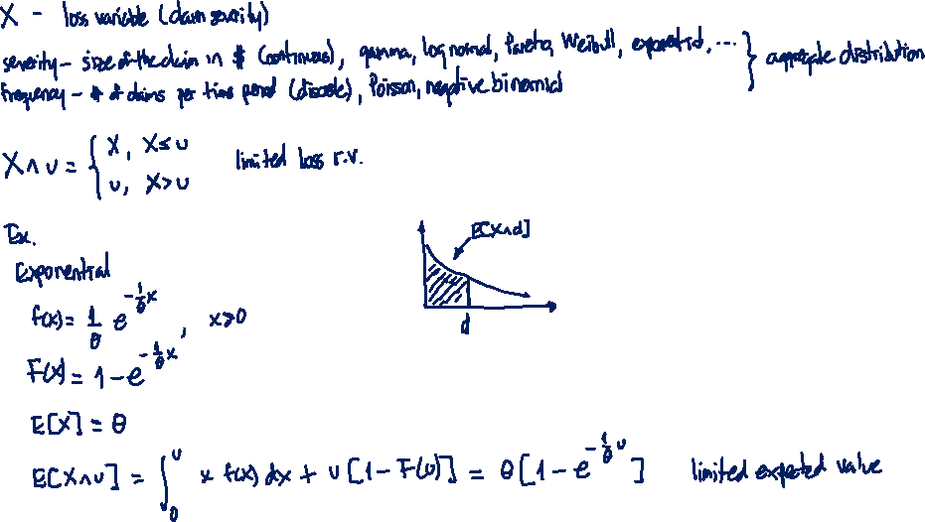

Limited Loss Random Variable & Limited Expected Value

Slide 7
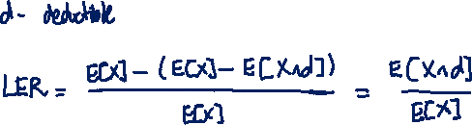

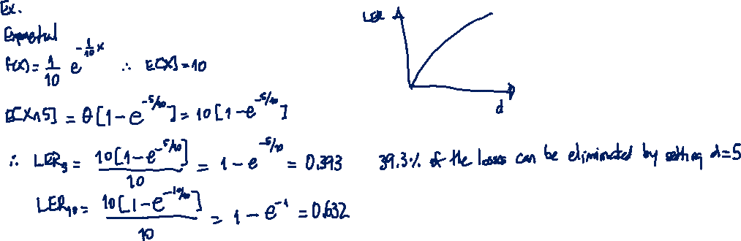
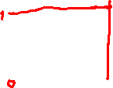
Loss Elimination Ratio
Ratio of the decrease in the expected payment with a deductible to the expected payment without the deductible

Slide 8
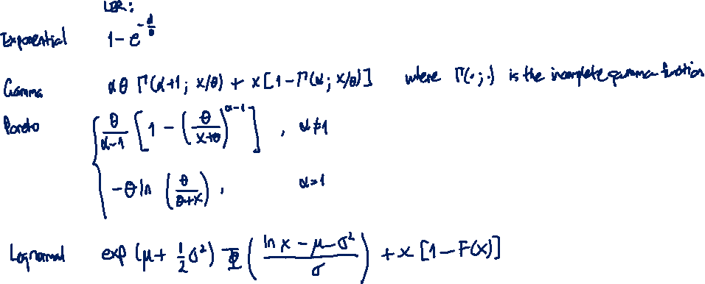
Loss Elimination Ratio
Ratio of the decrease in the expected payment with a deductible to the expected payment without the deductible

Slide 9
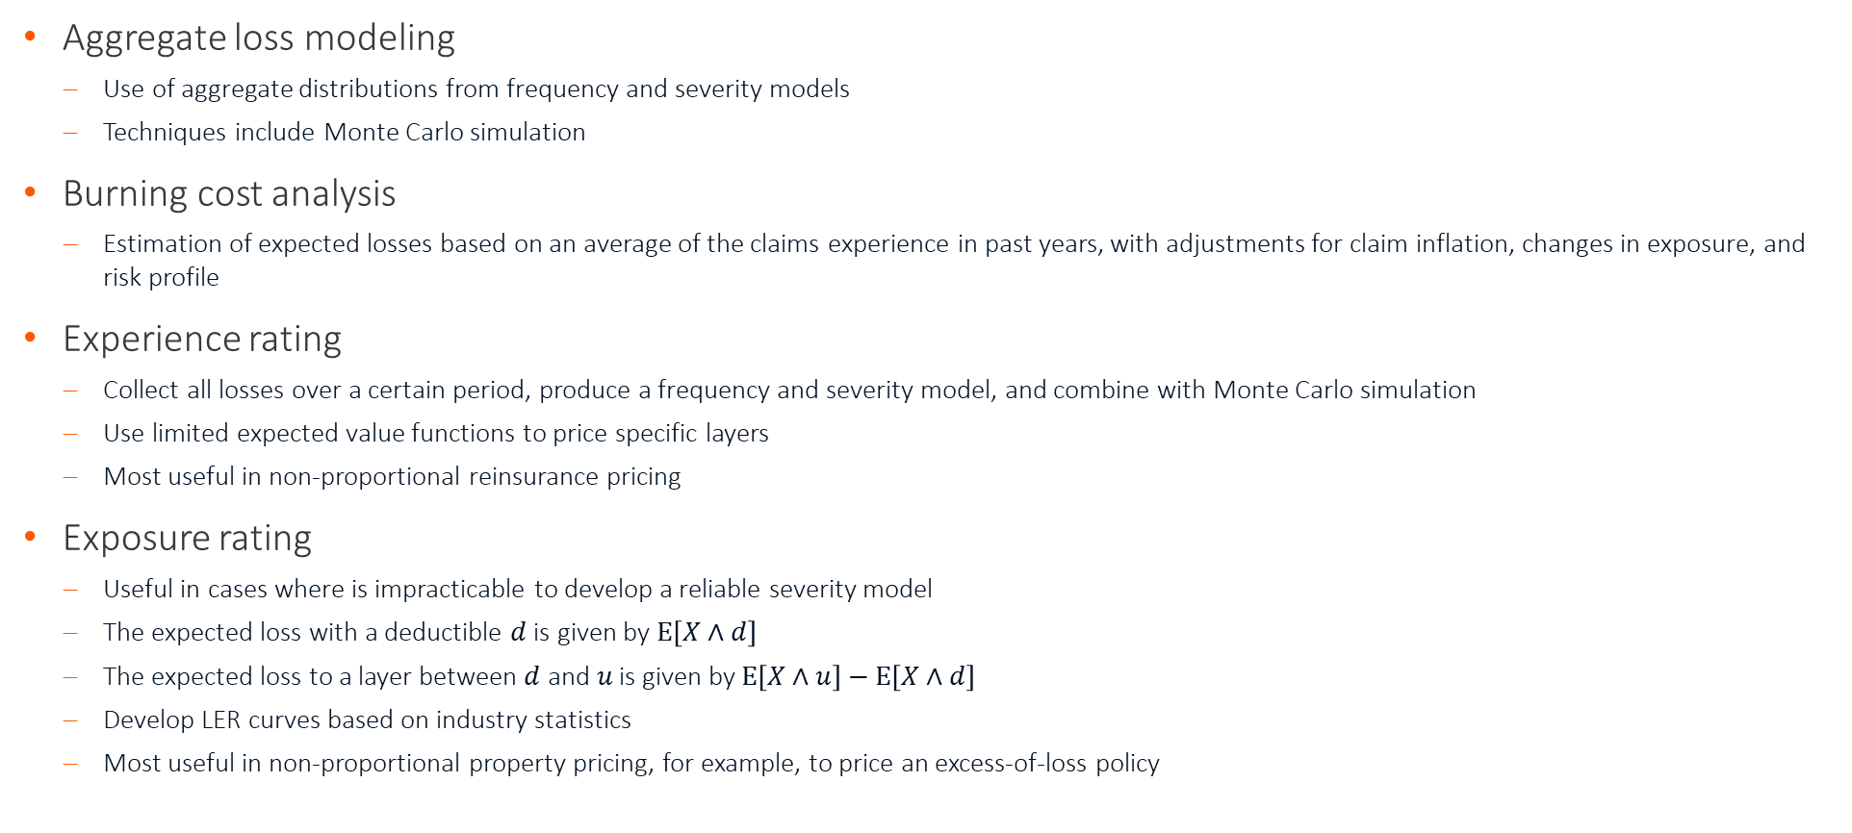
Basic Methodologies in P&C Insurance Pricing
Aggregate loss modeling
Use of aggregate distributions from frequency and severity models
Techniques include Monte Carlo simulation
Burning cost analysis
Estimation of expected losses based on an average of the claims experience in past years, with adjustments for claim inflation, changes in exposure, and risk profile
Experience rating
Collect all losses over a certain period, produce a frequency and severity model, and combine with Monte Carlo simulation
Use limited expected value functions to price specific layers
Most useful in non-proportional reinsurance pricing
Exposure rating
Useful in cases where is impracticable to develop a reliable severity model
The expected loss with a deductible $d$ is given by $E\left[X∧d\right]$
The expected loss to a layer between $d$ and $u$ is given by $\text{E}\left[X∧u\right]−E\left[X∧d\right]$
Develop LER curves based on industry statistics
Most useful in non-proportional property pricing, for example, to price an excess-of-loss policy

